Slide 1
Case Study
Analysis of the Historical Series of Fuel and LPG Prices - ANP 2023
linkedin.com/in/luis-felipe-jorge

Slide 2



Motivation
Challenge
To practice analytical skills and the ability to implement coding tools for the development of a study based on real data. To challenge oneself and consolidate learning through concrete experience.
Learn to consume data from multiple aggregator platforms (dados.gov.br, ibge.gov.br), integrate and process them to generate insights about the context, and explore different visualizations to represent the information accurately and efficiently.
linkedin.com/in/luis-felipe-jorge

Slide 3
Context
"In compliance with the provisions of the Petroleum Law (Law No. 9478/1997, Article 8), ANP monitors the prices practiced by automotive fuel retailers and liquefied petroleum gas (LPG) packaged in 13-kilogram cylinders (GLP P13), through a weekly price survey conducted by a contracted company."
The purpose of this case study is to analyze and understand the behavior of fuel prices over the past 5 years (2nd half of 2019 - 2nd half of 2023) and to answer questions that help clarify the information present in the data, such as:
How have fuel and LPG prices varied over time?
What were the periods of greatest volatility?
Is there a trend in prices over the years?
How do prices behave in different regions and states of Brazil over time?
linkedin.com/in/luis-felipe-jorge

Slide 4
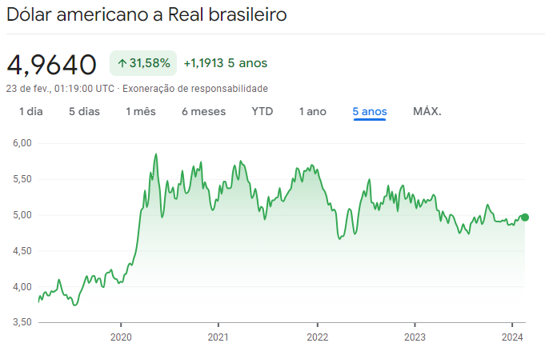
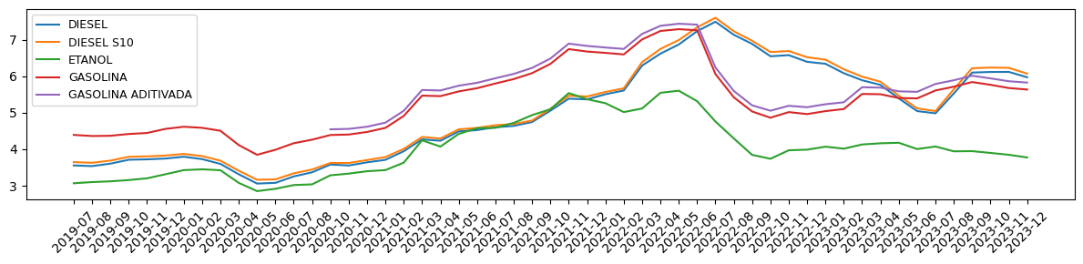
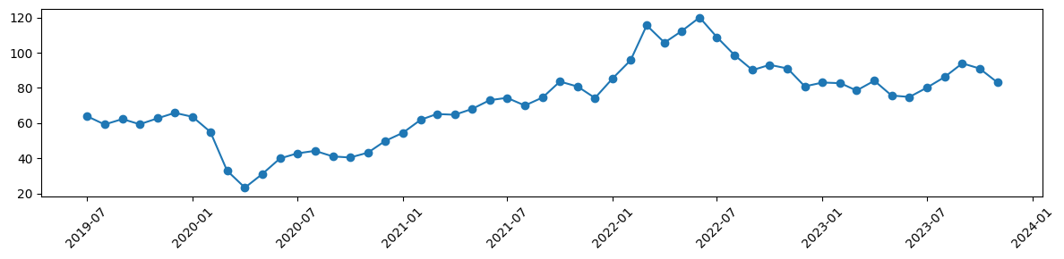
Temporal Analysis
Impact of Oil on Brazilian Fuel Prices
Temporal Evolution of Fuel Prices
Average Sampled Price (R$/Liter)
Google Finance
Temporal Evolution of Crude Oil Prices
Fuel prices follow the curve of oil barrel prices, especially in peaks and troughs.
Petrobras' pricing policy, based on international oil and dollar quotations, directly influences fuel prices in Brazil.
Since early 2020, the dollar has seen a significant increase, altering the historical levels of fuel prices in the country.
Average Price USD
linkedin.com/in/luis-felipe-jorge

Slide 5
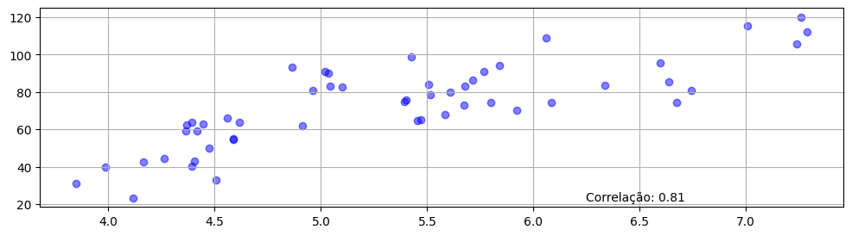
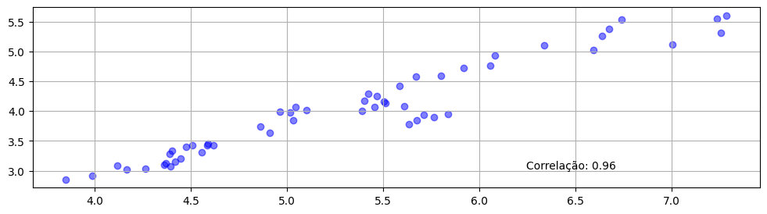
Temporal Analysis
Weight of Oil Price Dependence
This correlation is explained by the dynamics of the Brazilian fuel market, where ethanol and gasoline compete directly, especially due to the predominance of flex-fuel cars in the country.
When gasoline prices rise, drivers switch to ethanol, pushing up ethanol prices. Similarly, when gasoline prices fall, gasoline becomes more competitive, resulting in a reduction in ethanol prices to maintain competitiveness.
This indirect relationship shows that the price of ethanol is strongly linked to the price of gasoline and, by extension, the price of oil, demonstrating a complex interconnection in the fuel market.
A correlation is observed between the price of gasoline and the price of crude oil
Average Crude Oil Price (USD)
Average Sampled Gasoline Price (R$/Liter)
The same behavior is repeated in ethanol, a non-petroleum-derived fuel
Average Sampled Ethanol Price (R$/Liter)
Frota Flex no Brasil - UOL
linkedin.com/in/luis-felipe-jorge
Average Sampled Ethanol Price (R$/Liter)

Slide 6
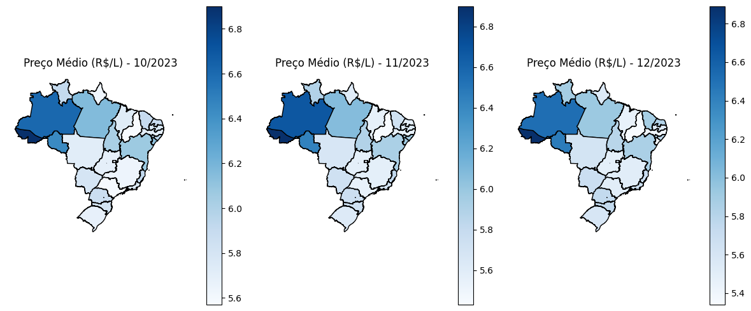
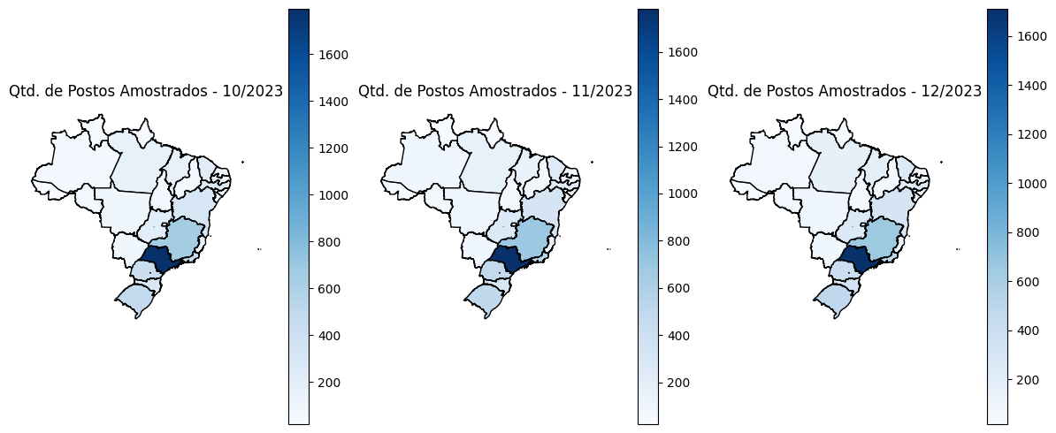
Regional Analysis
Regional Disparity in Gasoline Prices
Average Price
Average Price
Average Price
The South and Southeast regions have the lowest gasoline prices, while the North and Northeast regions have the highest prices.
The density of sampled stations reflects the actual density of stations in each state.
Regions with a higher density of stations have lower prices due to competition among sellers, while less concentrated regions have higher prices due to transportation costs and lower price competition influence.
number of sampled gas stations
number of sampled gas stations
number of sampled gas stations
linkedin.com/in/luis-felipe-jorge

Slide 7
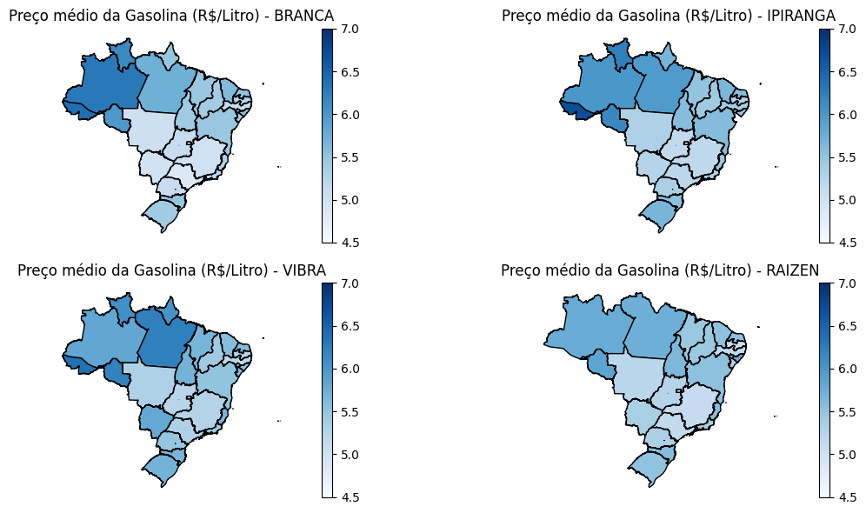
Regional Analysis
Impact of Brand on Fuel Prices
Gasoline Average Price
Gasoline Average Price
Unbranded stations, on average, had a lower selling price last year (2023) on fuel prices. The price difference is more evident in regions with a higher concentration of stations (SP, MG, RJ, and RS), where competition is more aggressive.
The brand that exerted the highest average fuel price across most products among regions was VIBRA, formerly BR distributor.
Gasoline Average Price
Gasoline Average Price
Valor Médio Amostrado em todo 2023
BRAND | DIESEL | DIESEL S10 | ETANOL | GASOLINA | GASOLINA ADITIVADA | GNV
BRANCA | R$ 5,67 | R$ 5,76 | R$ 3,90 | R$ 5,42 | R$ 5,54 | R$ 4,69
IPIRANGA | R$ 5,82 | R$ 5,94 | R$ 4,01 | R$ 5,58 | R$ 5,77 | R$ 4,73
RAIZEN | R$ 5,72 | R$ 5,82 | R$ 3,95 | R$ 5,52 | R$ 5,82 | R$ 4,52
VIBRA | R$ 5,84 | R$ 5,95 | R$ 4,14 | R$ 5,61 | R$ 5,78 | R$ 4,60
linkedin.com/in/luis-felipe-jorge

Slide 8
Highlights
Common sense already predicts that the price of petroleum-derived fuels will depend on the price of the original raw material. However, it is interesting to see that due to the characteristics of the fuel market dynamics in Brazil (type of fleet and consumer profile), the same weight and influence are indirectly transmitted to non-derived fuels, such as ethanol.
Two important factors for determining fuel prices are:
Geographical location:
Proximity to refineries, mostly located near the coast, and the diversification of sales stations among regions impact the average price exerted on consumers.
Brand of retailer:
There is also a clear price difference exercised between the main direct-to-public retail brands. Traditional brands, which have a larger market presence, can exert prices on average R$ 0.20 per liter higher than smaller brands, grouped under 'BRANCA' (unbranded).
linkedin.com/in/luis-felipe-jorge

